Slide 1
Basic 4 Review - Jeopardy
Vocabulary
20 points | 20 points |  | 20 points | 20 points | 20 points
30 points | 30 points |  | 30 points | 30 points | 30 points
40 points | 40 points |  | 40 points | 40 points | 40 points
50 points | 50 points |  | 50 points | 50 points | 50 points
Questions
Picture
this
Adjective
Grammar

Slide 2
Question: Vocabulary for 20 points
What is a kitchen?

Slide 3
Answer: Vocabulary for 20 Points
It’s a room where people cook and eat.

Slide 4
Question: Vocabulary for 30 points
What is furniture?

Slide 5
Answer: Vocabulary for 30 points:
It is word that refers to beds, sofas, tables, etc.

Slide 6
Question: Vocabulary for 40 points
What does outgoing mean?

Slide 7
Answer: Vocabulary for 40 Points
It means a fun and sociable person

Slide 8
Question: Vocabulary for 50 points
Name 10 jobs ☺

Slide 9
Answer: Vocabulary for 50 points
…..

Slide 10
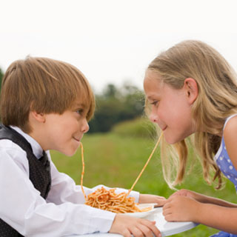

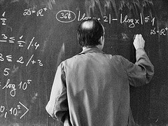
Question: Verb for 20 Points
What does share mean?

Slide 11
Answer: Verb for 20 Points

Slide 12
Question: Verb for 30 points
Mention 4 skills that you have, and 2 you don’t have

Slide 13
Answer: Verb for 30 Points
I can ….
I can’t…

Slide 14
Question: Verb for 40 points
What verbs go with clothes?

Slide 15
Answer: Verb for 40 points
Wear, wash, buy, etc.

Slide 16
Question: Verb for 50 points
Mention 2 things you want, 2 things you want to do, and two things you have to do this year.

Slide 17
Answer: Verb for 50 points
I want…
I want to….
I have to…

Slide 18
Question: Adjective for 20 points
What does impulsive mean?

Slide 19
Answer: Adjective for 20 points
It means
-a person who does things without thinking about it

Slide 20
Question: Adjective for 30 points
What does windy mean?

Slide 21
Answer: Adjective for 30 points
It means
-there is a lot of wind

Slide 22
Question: Adjective for 40 points
What does affordable mean?

Slide 23
Answer: Adjective for 40 points
It means
-not expensive

Slide 24
Question: Adjective for 50 points
What do creative and independent mean?

Slide 25
Answer: Adjective for 50 points
It means
-to have a good imagination
-to not depend on other people. Do things for yourself

Slide 26
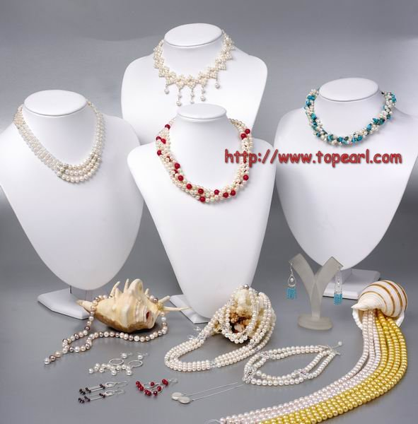
Question: Picture this for 20 points

Slide 27
Answer: Picture this for 20 points
jewerly

Slide 28
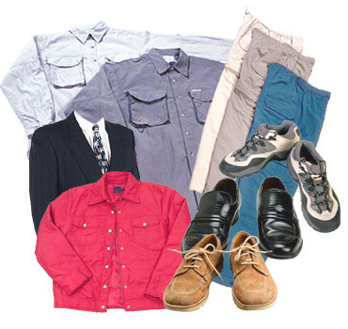
Question: Picture this for 30 points

Slide 29
Answer: Picture this for 30 points
3 pairs of pants
3 pairs of shoes…

Slide 30
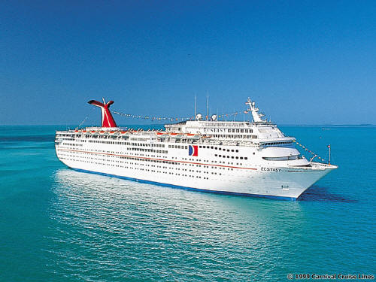
Question: Picture this for 40 points

Slide 31
Answer: Picture this for 40 points
A cruise ship

Slide 32
Question: Picture this for 50 points

Slide 33
Answer: Picture this for 50 points
Jewerly

Slide 34
Question: Grammar for 20 points
What can you and your parents do?

Slide 35
Answer: Grammar for 20 points
I can...
My mother can..
My father can…

Slide 36
Question: Grammar for 30 points
I don´t ____ a job now, so I am looking ___ a job on El Comercio

Slide 37
Answer: Grammar for 30 points
For
have

Slide 38
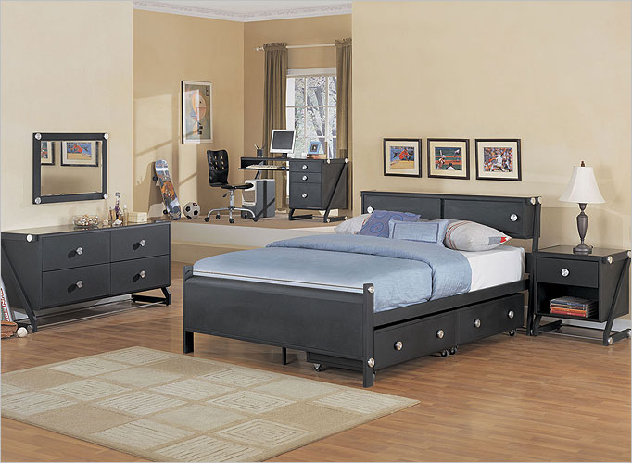
Question: Grammar for 40 points
Describe the picture using there is /are

Slide 39
Answer: Grammar for 40 points
There is….
There are…..

Slide 40
Question: Grammar for 50 points
Ask a member of your group for his/her personality. And the other person has to answer

Slide 41
Answer: Grammar for 50 points
What are you like?
I am…..

